Slide 1
Introduction to Machine Learning: A Hands-on Workshop
Zoë Wilkinson Saldaña, MSI
Arcus Education, DBHi

Slide 2

Hello!
Background: data science in academic libraries (Cornell University, University of Michigan)
Research interests: critical data science pedagogy; open source collaboration; reproducibility
Zoë Wilkinson Saldaña, MSI
Data Instructional Specialist
Arcus Education

Slide 3
Machine Learning with METACHOP
Introduction to Machine Learning *
Machine Learning II / Topics in ML

Slide 4
Machine Learning with METACHOP
Our schedule for today:
Presentation + Colab Setup: 12:10pm – 1pm
Hands-on Notebooks: 1pm– 2:30pm
Wrap-up discussion: 2:30pm-2:50pm
Self-guided work, learner questions: Here till 3:30pm

Slide 5
TAKEAWAYS
Critically apply machine learning methods to research questions
Develop + iterate on a classification pipeline (using scikit-learn)
Find peers, colleagues, collaborators, co-learners

Slide 6

Turn to your neighbors
What project or problem are you currently working on that you hope to apply machine learning to?
What is the most important thing you hope to learn today?
Icons made by Freepik from www.flaticon.com

Slide 7
Why approach a research question with machine learning?

Slide 8
What is machine learning?

Slide 9
What is machine learning?
Generalizing from observed data to new, previously unobserved data (e.g. future observations, new datasets in problem domain)
Focused on prediction tasks such as assigning a label or value
Data-driven models that “learn” when exposed to training data

Slide 10
Relationship to Statistics
Statistics
model first
inference emphasis
Machine learning
data first
prediction emphasis

Slide 11
Types of machine learning

Slide 12
Types of Machine Learning
Supervised
Unsupervised
Reinforcement

Slide 13
Supervised learning
Given input variables or features, predict the correct output or target
Can predict two types of target:
label (benign /malignant) or
quantity (9 hours)
Relies on labeled training data
(x_{i},yi)∝p(x,y) i.i.d.
x_{i}∈ℝ^{p}
y_{i}∈ℝ
f(x_{i})≈y_{i}

Slide 14
Supervised learning
Given input variables or features, predict the correct output or target
Can predict two types of target:
label (benign /malignant) or
quantity (9 hours)
Relies on labeled training data

Slide 15
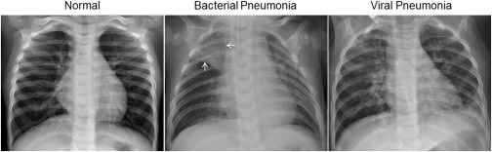
Examples of Supervised Learning
Detecting spam/no spam based on e-mail characteristics
Predicting clinical event based on NICU vitals
Diagnosing pathology based on image data
Assigning class (normal/bacterial pneumonia/viral pneumonia) to chest X-rays

Slide 16
Generalization
Not only f(xi)≈yi
Also for new data: f(x)≈y
Generalize from:
Training -> test data
Training -> new observations in field
Training -> new observations in subsequent studies
…
Training -> new observations in totally different domain

Slide 17
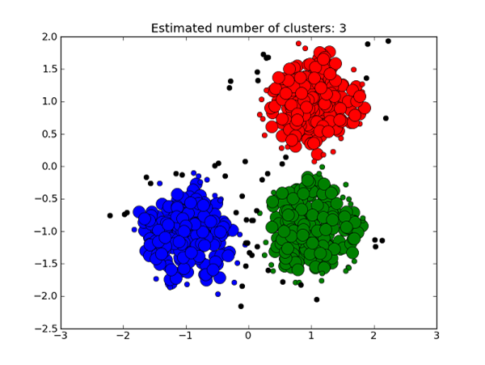
Unsupervised Learning
Given input features, assign to a cluster or class
System must detect groups ”on its own” – training data doesn’t have labels
x_{i}∝p(x) i.i.d.
Learn about p.
https://medium.com/deep-math-machine-learning-ai/different-types-of-machine-learning-and-their-types-34760b9128a2

Slide 18
Unsupervised Learning
Two main use cases:
Clustering: detect k groups of observations and assign new observations a group
Dimensionality reduction: reduce the number of variables in data while losing as little information as possible
“clustering for variables”

Slide 19
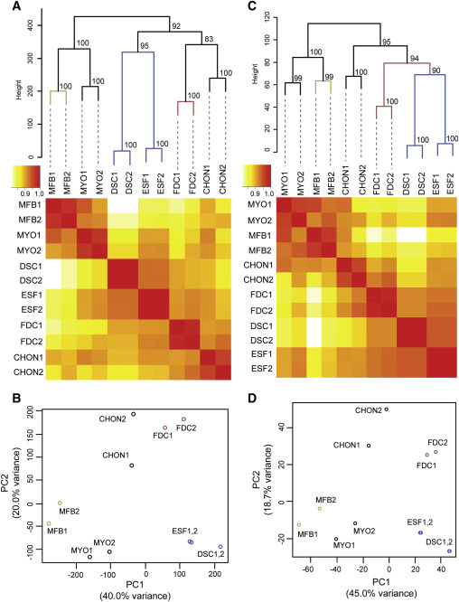
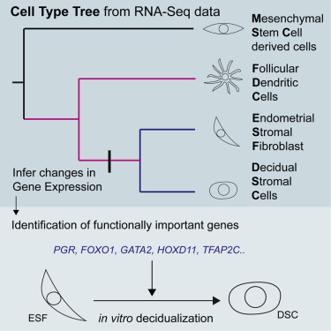
Kin, K., Nnamani, M. C., Lynch, V. J., Michaelides, E., & Wagner, G. P. (2015). Cell-type phylogenetics and the origin of endometrial stromal cells. Cell reports, 10(8), 1398-1409.

Slide 20
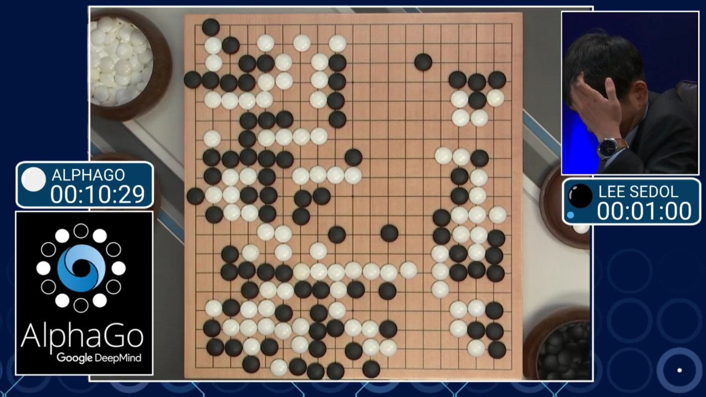
Reinforcement Learning

Slide 21
Features and targets
Features are all the variables you will use to make a prediction. We could have 3, 4, 100, 1,000, or 6 million features..
Targets are the outcome variables we are trying to predict. For a given ML task, this is almost always a single variable (categorical or numeric).

Slide 22
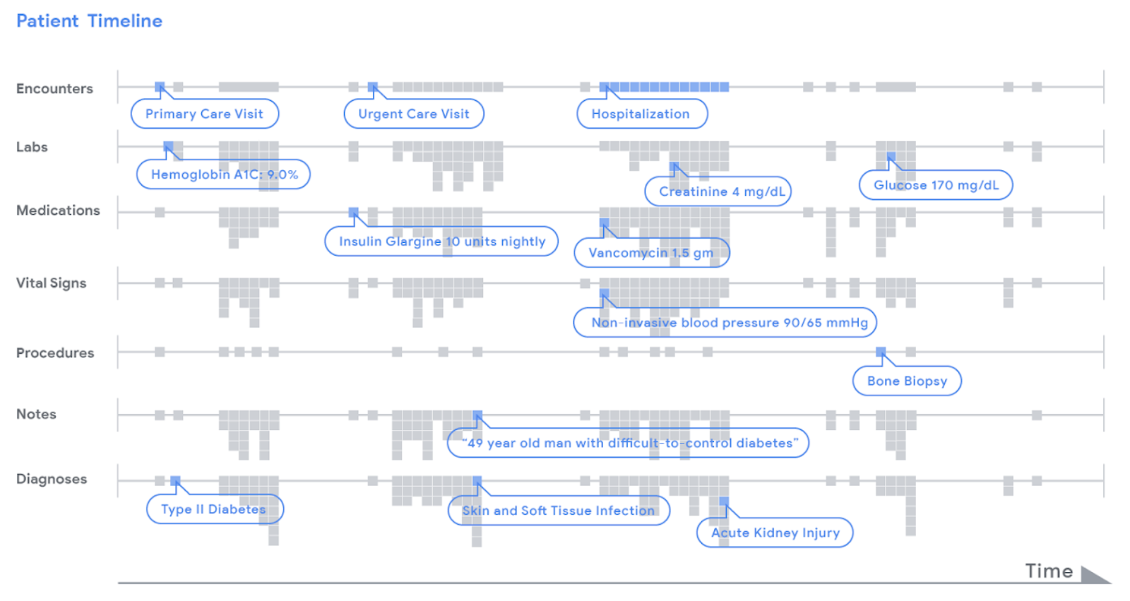
Features and targets
https://ai.googleblog.com/2018/05/deep-learning-for-electronic-health.html

Slide 23
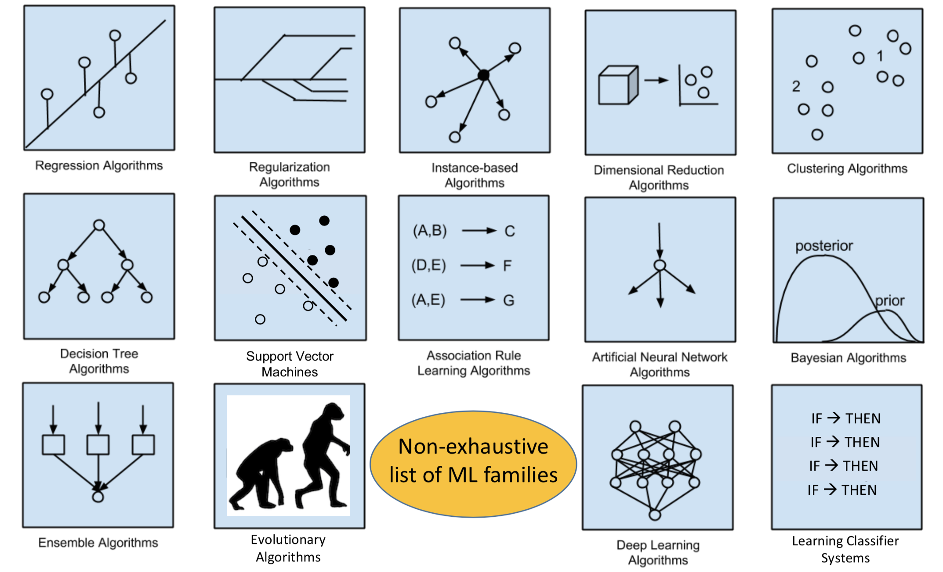
Model selection (& “no free lunch” theorem)

Slide 24
Start with your task + data
1) Am I predicting a quantity (continuous) or a label (categorical)?
2) Is my training data labeled? (do I know the “right answer”?)
3) Am I trying to reduce complexity to prepare for more analysis?

Slide 25
Model selection (& “no free lunch” theorem)

Slide 26
Model selection (& “no free lunch” theorem)
Training data labeled w/ outcomes?

Slide 27

Choosing the right estimator in scikit-learn
https://scikit-learn.org/stable/tutorial/machine_learning_map/index.html
https://scikit-learn.org/stable/tutorial/machine_learning_map/index.html

Slide 28
Bias and variance

Slide 29
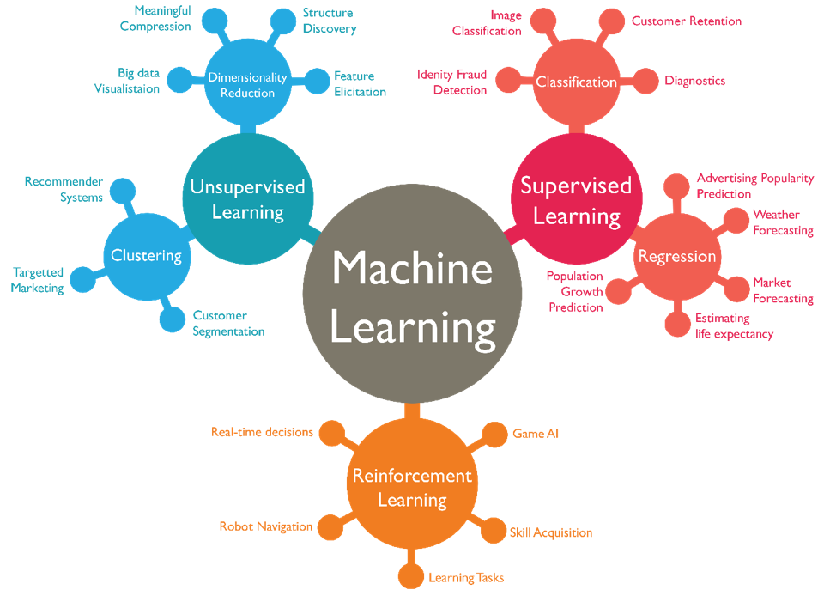

Slide 30
Turn to your neighbors
As a table, come up with an example of a research question that could be approached with:
Supervised learning
Unsupervised learning
Reinforcement learning
What data would you need?
Icons made by Freepik from www.flaticon.com

Slide 31
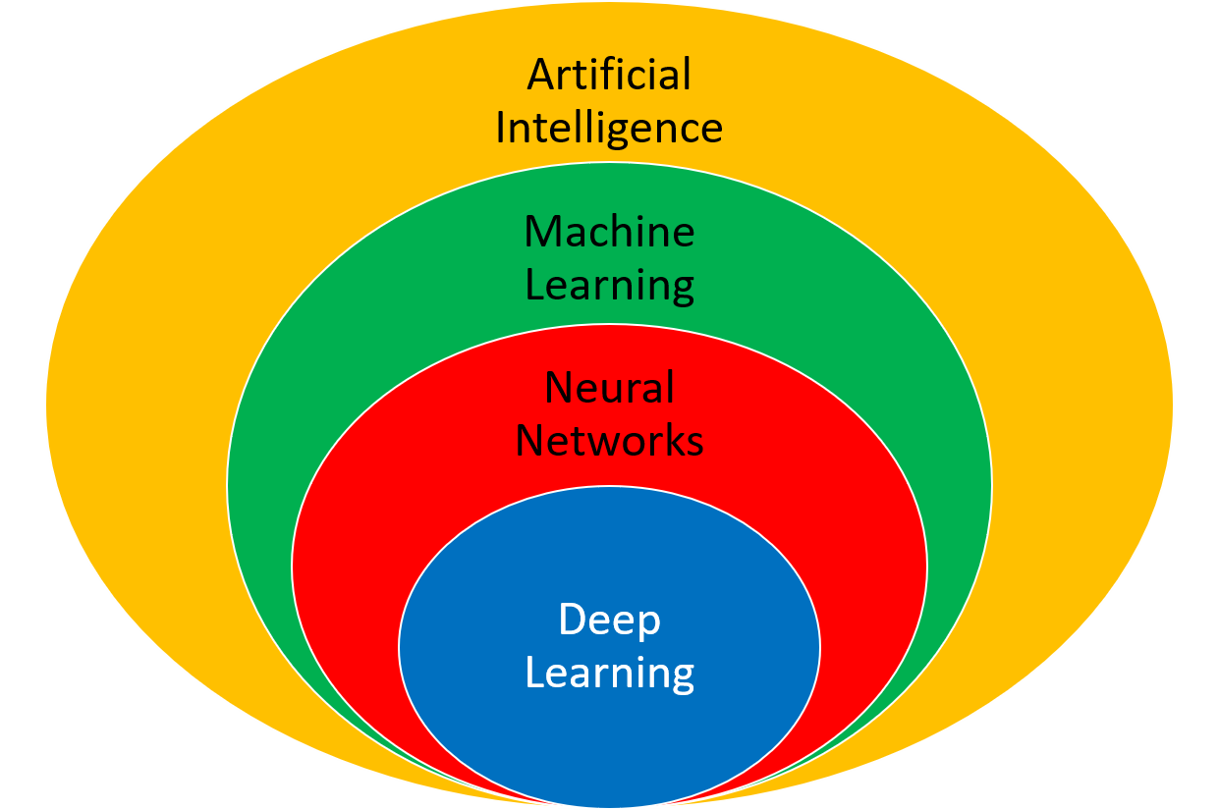
Other kinds of learning
Semi-supervised
Active Learning
Forecasting
…
https://apmonitor.com/do/index.php/Main/DeepLearning

Slide 32
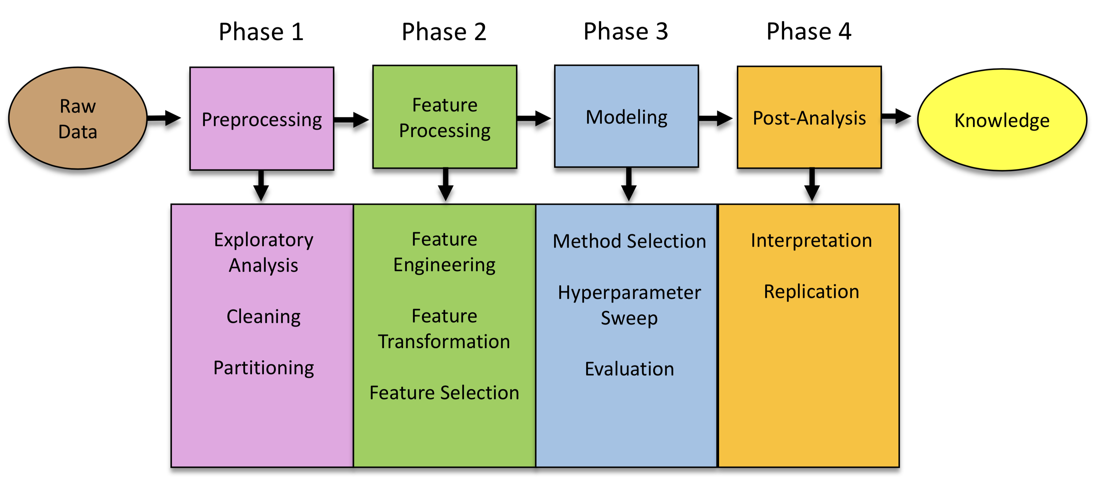
For today

Slide 33
The full spectrum

Slide 34

For today

Slide 35
https://www.sciencedirect.com/science/article/pii/S0092867418301545?via%3Dihub
https://www.youtube.com/watch?v=EuBBz3bI-aA

Slide 36
Communicating Results
Explainable results
Meaningful coefficients (e.g. odds ratios in logistic regression)
Influence of features on estimator
Interpretable rules in estimator function (e.g. decision tree vs random forest vs neural network)
Are metrics of performance or reliability meaningful for your domain?

Slide 37
A quick note on R vs Python
https://www.dataquest.io/blog/python-vs-r/

Slide 38
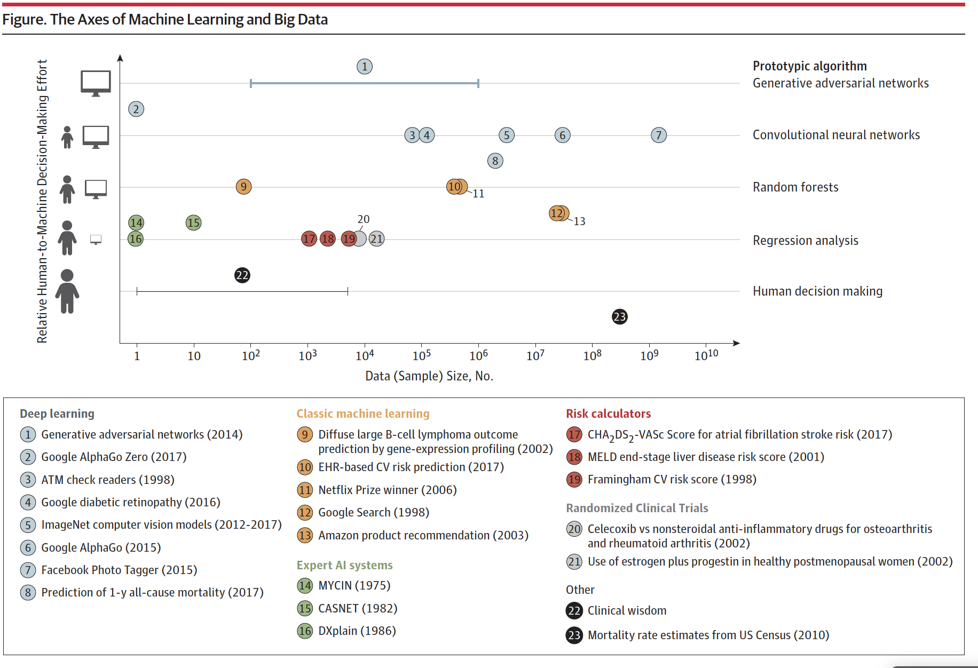
“Big Data and Machine Learning in Health Care” (2018)

